Slide 1

National Joint Annual Review 2081/82
Government of Nepal
Ministry of Health and Population

Slide 2
Organization of Ayurveda Health Service
Ministry of Health and Population (MoHP)
DoAA
SDVK
NAMC
NARTC
Ayurveda Hospital, Naradevi
Pashupati Homeopathy Hospital
National Ayurveda, Panchakarma and Yoga Centre (Under Establishment)
Provincial Ayurveda Hospital - 4
District Ayurved Health Centre-60
Ayurveda Aushadhalaya - 304
Nagarik Aarogya Kendra - 411
Distric level- Ayurveda and Alternative Hospitals- 15
Local level Ayurveda Hospital-1

Slide 3
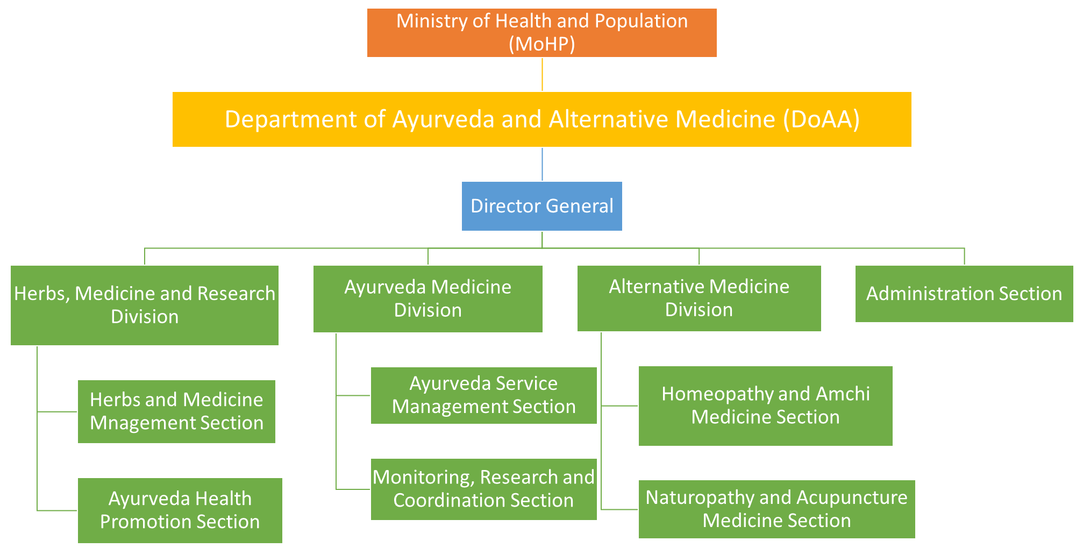
Organogram of DoAA

Slide 4
Progress on Key Indicators
SN | Indicators | 2079/80 | 2080/81 | 2081/82
1 | Number of public facilities providing Ayurveda services | 388 | 388 | 388
2 | Number of people served with Therapeutic Yoga services | 153513 | 187181 | 217280
3 | Number of Nagarik Aarogya committee formed | 6729 | 7170 | 4782
4 | Number of Breast feeding Mothers taken Satawari Churna | 59036 | 58467 | 51508
5 | Number of Senior Citizens served with Jestha Nagarik Sewa | 323217 | 353917 | 374470
6 | Number of Students benefited with School Ayurveda and Yoga education | 78754 | 87240 | 74415
7 | Number of Schools benefited with School Ayurveda and Yoga education | 7917 | 9622 | 4037
8 | Number of people served with Purvakarma Sewa | 400483 | 488418 | 603245
9 | Number of People served with Parasurgical and Surgical service | 12617 | 31404 | 38996
10 | Number of People served with Laboratory Service | 102630 | 155860 | 201337
11 | Number of Citizen well being Campaign conducted | 7370 | 4250 | 9653

Slide 5
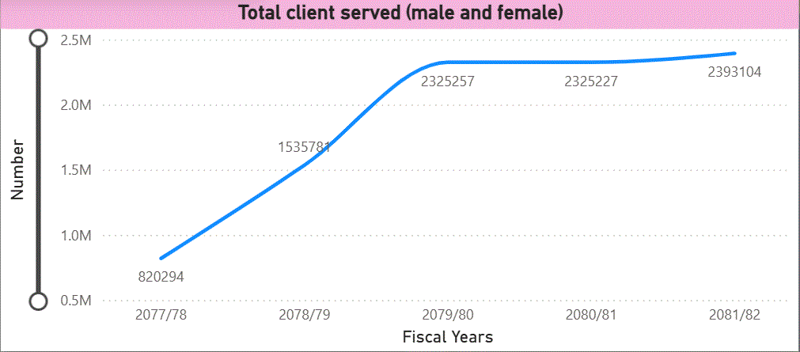
Ayurveda Service last 5 years trends:

Slide 6
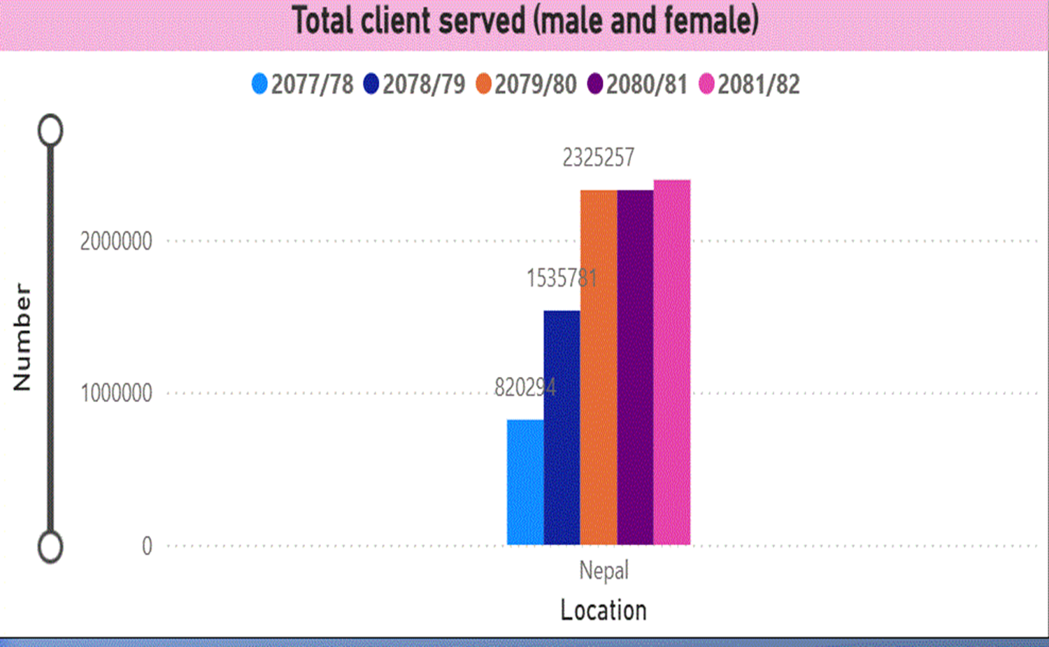
Ayurveda Service last 5 years trends:

Slide 7
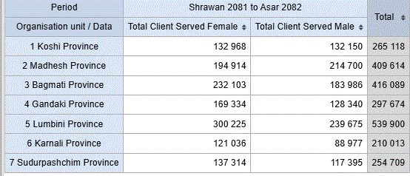
Clients Served by Province: FY 2081_082

Slide 8
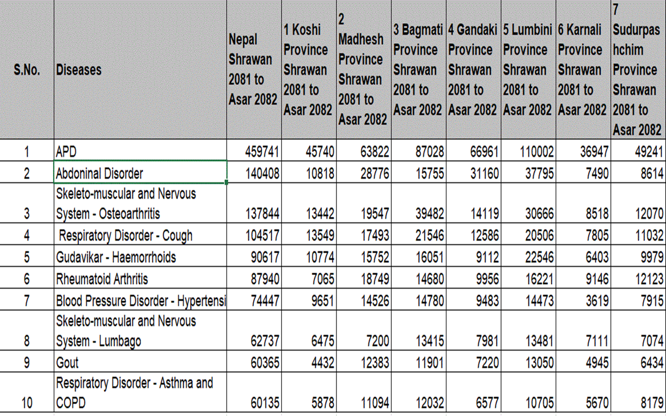
Top 10 Disease by Province: FY 2081_082

Slide 9
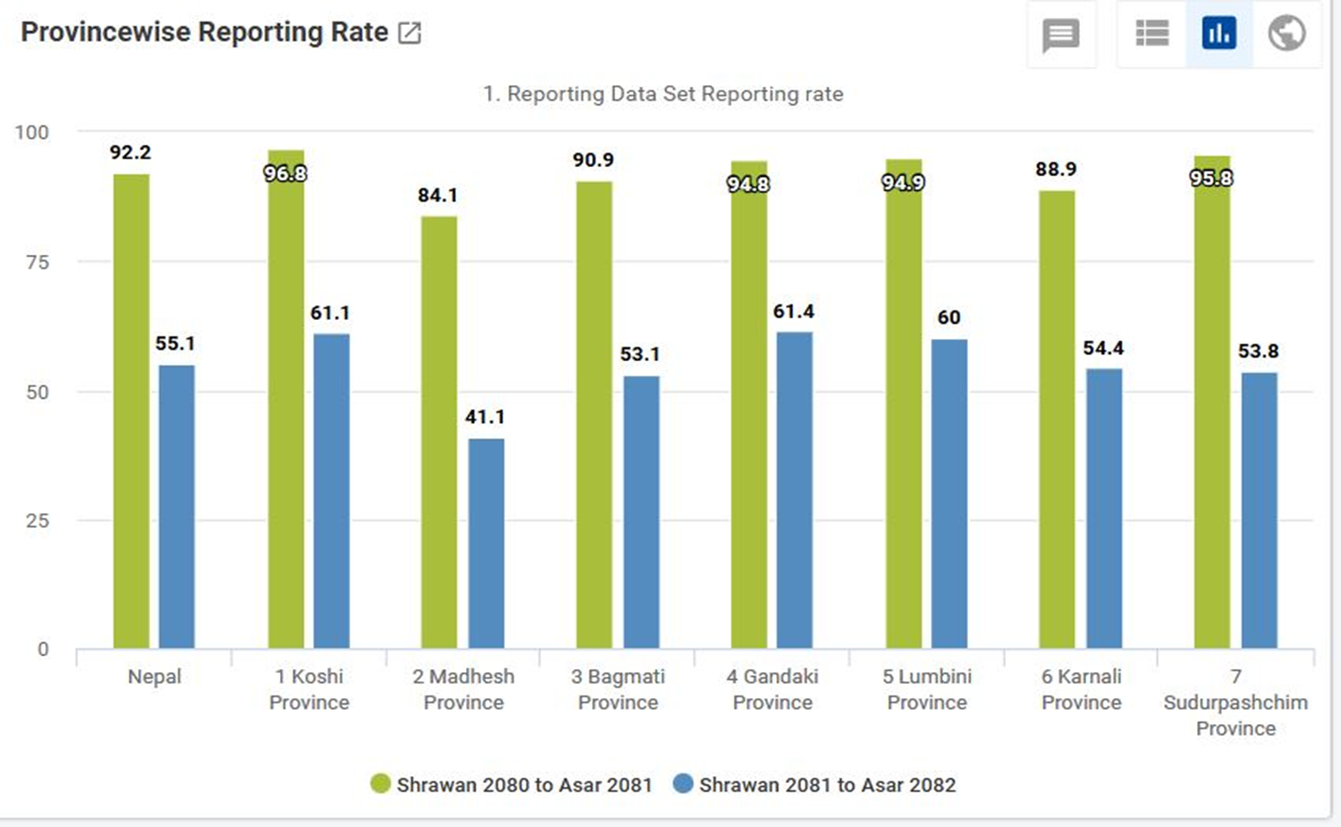
TOTAL POPULATION SERVED WITH AYURVEDA AND ALTERNATIVE SERVICES FIVE YEAR TRENDS

Slide 10
Delivery of Free Basic Health Service (Ayurveda)
1. Stanpayi Aama lai Shatawari vitarana Karyakram (Shatavari, Asparagus racemosus, a galactagogue medicines distribution program to lactating mother)
To reduce maternal and infant mortality, the health of mothers and child has been promoted through Shatavari (Asparagus racemosus, a galactagogue medicines ) distribution program to lactating mother. (Service receipant=43662 )
2. Purvakarma service (Snehana-Oileation, Swedana-Medicated steaming)
This service is provided through Ayurveda institutions. It is curative and Promotive service. (Service receipant= 197616 )

Slide 11
Delivery of Free Basic Health Service (Ayurveda)
3. Yoga Service
To prevent non-communicable diseases (including mental disorders) Ayurveda, yoga and lifestyle management programs were carried out in collaboration with the local level, and public awareness was enhanced by conducting citizen health campaigns and community health education programs through citizen wellbeing group (Nagarik Arogya Samuha). (Service recipient=390413 )

Slide 12
Issues and Challanges for delivery of Free Basic Health Service (Ayurveda)
Lack of outlet and manpower in each local level.
Inadequate budger for providing Shatawari through out for 6 months.
Local level government has not given priority for BHS (Ayurveda)
Lack of capacity building training to local level manpower
Lack of coordination between birthing centers and Ayurveda health facilities.
Interruption of budgeting in BHS(Ayurveda)

Slide 13
Way for delivery of Free Basic Health Service (Ayurveda)
Mobilization of FCHV for awareness of BHS(Ayurveda) and distribution of Shatawari
Establishment of Nagarik Arogya kendra for remaining local level
Ensure proper budgeting and continuation of BHS(Ayurveda) from Ayurveda health facilities.
Capacity building training on BHS(Ayurveda)
Awareness and orientation programe for local level about BHS(Ayurveda)

Slide 14
Progress on FY 2081/82 AWPB Key Activities
Service delivery from the Citizen Health Service Centers has started to be reported through AHMIS.
Personnel working at local-level dispensaries have been oriented on MSS (Minimum Service Standards) to enable them to prepare evidence-based plans.
The capacity of staff of local-level Ayurvedic institutions providing basic Ayurvedic services has been enhanced.
From the current fiscal year, the Citizen Health Service Center will be expanded to 444 local levels where Ayurvedic institutions are not yet established.
In current fiscal year, the Swarna Bindu Prashan program will be implemented as a model in 25 locations.

Slide 15
Progress on FY 2081/82 AWPB Key Activities
Ayurvedic Health Information System training was provided to 42 health workers at the Pathlaiya Health Training Center, Bara District, Madhesh Province.
Under the NCD Control Campaign (a one-month campaign conducted in Falgun 2081 for the identification of non-communicable diseases), 47,000 patients benefited from services such as blood pressure measurement, kidney disease screening, BMI measurement, and sugar testing, among others, provided by the bodies under this department.
In this fiscal year, a total of 2,410,000 service users received various Ayurvedic health services.

Slide 16
Progress on FY 2081/82 AWPB Key Activities
Through Ayurveda and Yoga, Citizen Health Campaigns were conducted in 3,268 locations to promote a healthy lifestyle and reduce non-communicable diseases.
Under the Senior Citizens Program (providing Rasayana medicines and Panchakarma services), the health of 219,889 senior citizens was promoted.

Slide 17
Progress on FY 2081/82 AWPB Key Activities
Preparation of the Nepal Ayurveda Drug Formulary (Bheshaj Samhita) – Avaleha/Oil Section.
International Yoga Day celebrated with the participation of 240 individuals, and National Yoga Day celebrated with the participation of 150 individuals.
Orientation on School Ayurveda and Yoga Education conducted with the participation of 144 stakeholders.
Training on School Ayurveda and Yoga Education provided to 66 school teachers and nurses from Gandaki, Bagmati, and Madhesh Provinces.

Slide 18
Progress on FY 2081/82 AWPB Key Activities
Free distribution of Rasayana and other medicines along with general health check-ups was conducted for 280 senior citizens residing in Chautara, Pashupati, and Devghat elderly homes.
To promote a healthy lifestyle, Citizen Health Groups were formed in 1,490 locations.
The School Ayurveda and Yoga Education Program was implemented in various schools, benefiting a total of 165,362 students.
Number of schools where the School Ayurveda and Yoga Education Program was conducted:
By local levels: 610 schools
By the department: 32 schools
Total: 642 schools

Slide 19
Progress on FY 2081/82 AWPB Key Activities
A three-day orientation program on Naturopathy was conducted at the Nawalparasi East Naturopathy Hospital from 2081/09/21.
On 2081/03/20, the National Naturopathy Day 2025 was celebrated with the theme “Naturopathy in a Changing Lifestyle”, with the participation of experts in the related field.

Slide 20
Progress on FY 2081/82 AWPB Key Activities
Regarding Strengthening/Promotion of Acupuncture Services:On 2081/08/07, World Acupuncture Day 2081 was celebrated, and an Acupuncture Service Promotion Program was conducted with the participation of 70 health workers.
On 2081/09/14, an orientation program on Ayurvedic medicine was organized for 32 acupuncture assistants.
On 2081/09/17, a workshop on regulation and guideline formulation for institutions providing acupuncture services was held in Dhulikhel, Kavre District, with the participation of 51 individuals.

Slide 21
Progress on FY 2081/82 AWPB Key Activities
Other Key Achievements:Yoga draft has been prepared.
A 10-year work plan for Homeopathic treatment has been prepared.
The registration process for Sowa Rigpa doctors has been simplified, and the registration process with the relevant council has begun.
Coordination has been made with stakeholders for the development of Acupuncture treatment.

Slide 22
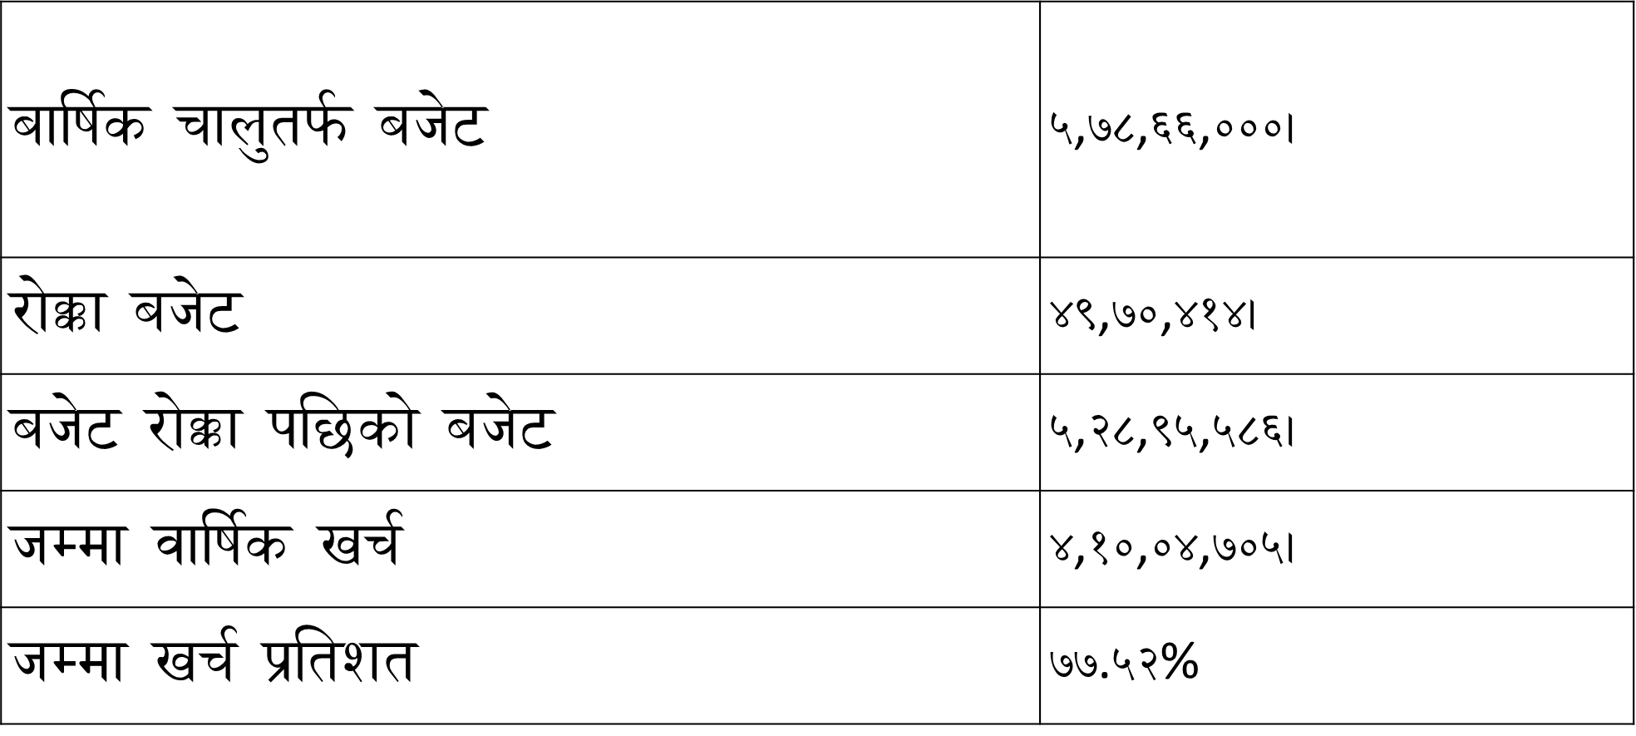
चालु तर्फको प्रगति

Slide 23
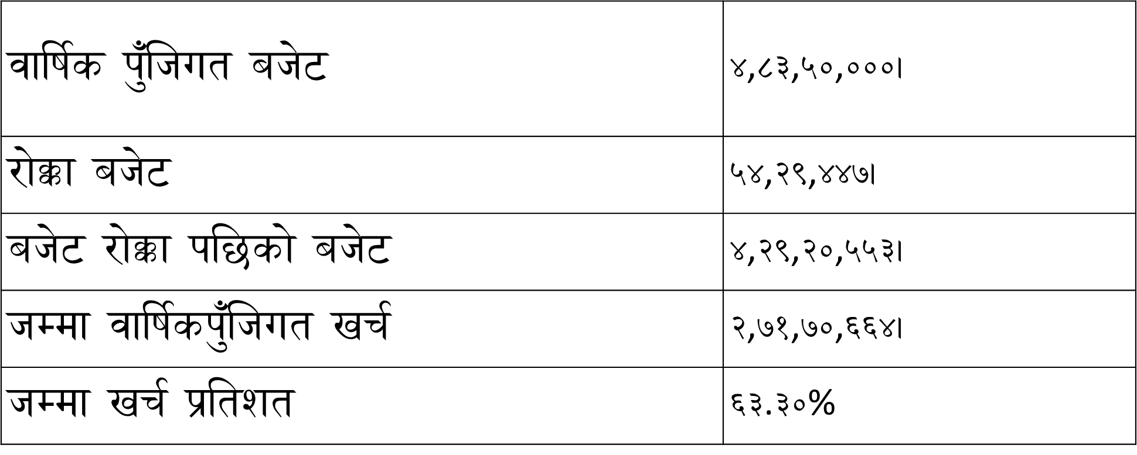
पुँजिगत तर्फको प्रगति

Slide 24
Status of Financial Irregularities
Total arrears up to the end of last fiscal year: Rs. 203,789
Settled in this fiscal year: Rs. 101,027
Settlement percentage: 49.57%

Slide 25
Progress status on initiatives from the 2080/81 NJAR
2080/81 Progress Status | 2081/82 Progress Status
Through Nagarik Arogya Karyakram (Citizen Well Being Program), screening, diagnosis, treatment and counseling of major non-communicable diseases (Diabetes, Heart and Blood Vessel related Diseases, Cancer, COPD) have been provided. National Ayurveda, Panchakarma and Yoga Center, Budhanilkantha building construction | 1. 47000 people are benefited during NCD campaign conducted during month of Falgun. 1490 Nagrik Arogya Samuha have been formed and involved with health promotion activities. 2. National Ayurveda, Panchakarma and Yoga Center, Budhanilkantha building construction is about to complete and will be handover within a month, while this center has now running its opd service since 10 month in its annex building.

Slide 26
Key Issues in the Field of Ayurveda and Alternative Medicine Services
Expansion of access to Ayurvedic health services
Quality of medicines and supply chain management
Streamlining of the Ayurvedic health information management system
Production and management of skilled human resources
Financial security in Ayurvedic health services
Application of research and innovation

Slide 27
Priorities and Solutions/Remedial Measures
1. Good Governance and Leadership: O&M survey, professional development, vocational training, study visits, and observation tours.
2. Improvement Based on MSS Scoring.
3. Health Infrastructure and Medicine Supply Chain: Implementation of building infrastructure and GMP standards; establishment of a new Drug Act for Ayurvedic medicines; creation of a dedicated division in the DDA with Ayurvedic experts for regulation of Ayurvedic medicines.
4. Health Human Resources: Studies, scholarships, and initiatives through the National Ayurveda Institute.
5. Health Service Flow: Integration of Ayurvedic services with basic hospitals (5/10/15 beds), and establishment of integrated medical hospitals in all seven provinces, including Ayurveda, Yoga, and Naturopathy services.
6. Health Information System: Strengthening AHMIS and mainstreaming it into HMIS (ICD 11 TM-II).
7. Financial Management: Adequate budget allocation and implementation of health insurance programs in Ayurvedic health services.

Slide 28
Key Issues, Challenges and Way Forward
Key Issues/challenges | Initiatives taken | Way forward
Inadequate Infrastructure | Coordination with line ministries | Strengthen Infrastructure and Logistics
Weak Supply Chain and Logistics | Coordination with Province for regular supply chain | Increase Budget and Financial Support
Inadequate Human Resources | Coordination with Ministry for O&M survey | O&M survey
Policy and Regulatory Challenges | Guidelines, Standards and Strategies are made | Implimentation of Ayurveda and Alternative Medicine Strategy-2082

Slide 29
Innovations
SWARNA BINDU PRASHAN AS PILOT PROGRAM IS STARTED IN 25 DIFFERENT LEVEL AYURVEDA HAELTH FACILITIES THROUGHOUT THE COUNTRY.
THIS PROGRAM IS FOCUSED ON HEALTH PROMOTION OF CHILDREN 1 TO 5 YEARS AND SUPPOSED TO BE HELPFUL FOR DECREASE MORBIDITY AND MORTALITY RATE IN THAT AGE GROUP.
INCLUSION OF ICD-11 TRADITIONAL MODULE 2 IN AHMIS AND AHMIS IS VISIBLE AS DASHBOARD ON WEBSITE AND ACCESSABLE FOR EVERYONE FOR DATA EXTRACTION AND USE.

Slide 30

धन्यवाद !

