Slide 1
Role of Ayurveda and Yoga in Sustainable Development of Health in Nepal नेपालमा दिगो स्वास्थ्य विकासमा आयुर्वेद तथा योग क्षेत्रको भूमिका
डा पुष्पराज पौडेल
शाखा प्रमुख
नीति योजना तथा अनुगमन महाशाखा
स्वास्थ्य तथा जनसंख्या मन्त्रालय
रामशाह पथ काठमाडौ

Slide 2

सुस्वागतम्

Slide 3
Table of Contents प्रस्तुतीका विषय सूचि
Definition of Health स्वास्थ्यको परिभाषा
Dimension of Health स्वास्थ्यको बहु आयामहरु
Evolution of Science for Man kind मानवीयताका लागि विकास
Ayurveda and Daily Life आयुर्वेद र दैनिक जीवन
Shanghai Declaration of Health Promotion स्वास्थ्य प्रवर्द्बनमा साङ्घाई घोषणा
Burden of diseases रोगको भार परिवर्तन
Sustainable Development goals in context to Health promotion and Diseases prevention
Surveys and finding on Health विभिन्न तथ्याङ्कमा स्वास्थ्य सम्बन्धी सूचकहरु
Key Home Messages सार संक्षेप सन्देश

Slide 4
के हो त दिगो विकास?

Slide 5




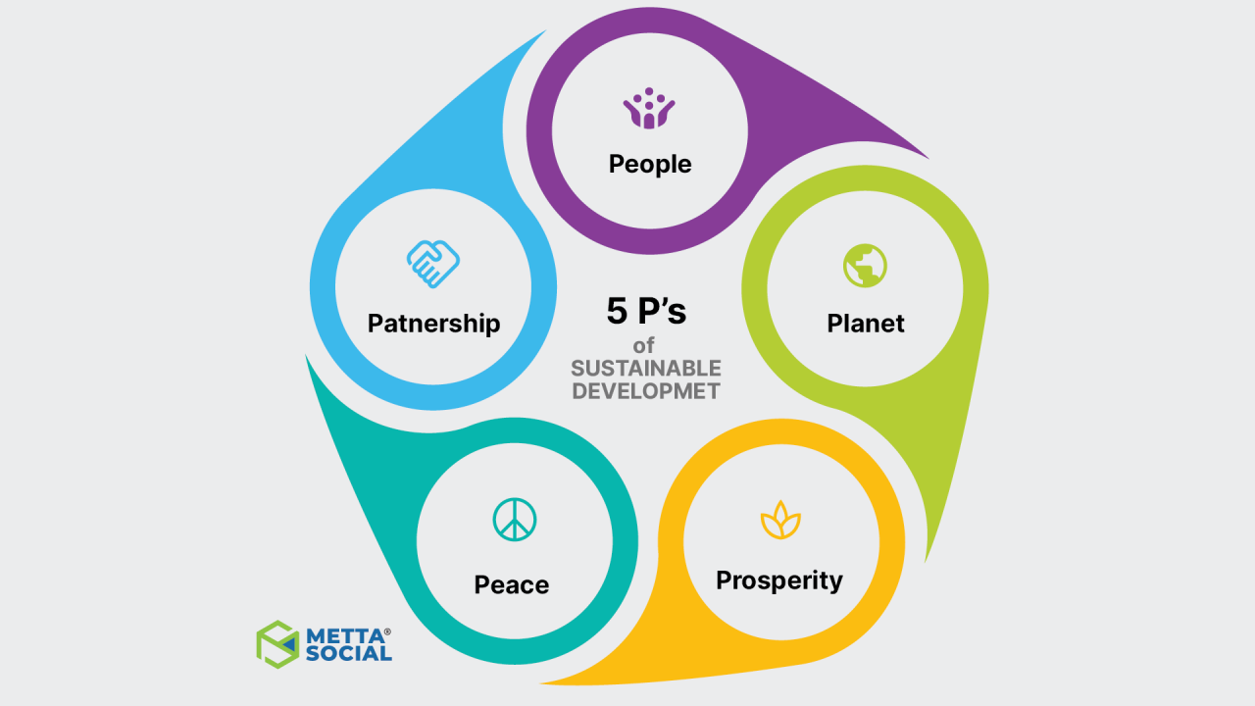
दिगो विकासका मुख्य दर्शन

Slide 6

दिगो विकासका लक्ष्यहरु

Slide 7
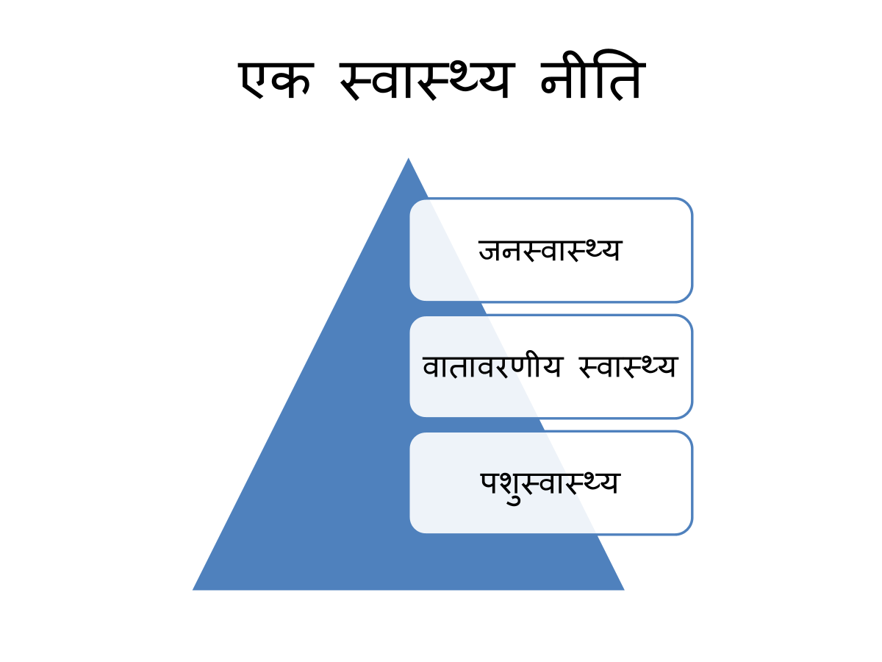
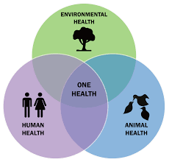
सर्व भूतानुकम्पया।।

Slide 8


Slide 9
कसरी आयुर्वेद तथा योगद्बारा स्वस्थ उत्पादनशील नागरिक बनाउन सकिन्छ।

Slide 10
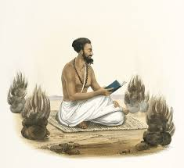

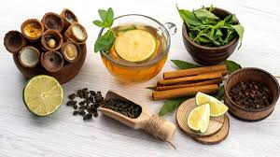
विकासक्रम
योगेन चित्तस्य पदेन वाचा मलं शरीरस्य वैद्यकेन।
योऽपाकरोक्त प्रवर मुनीनां पतञ्जलीं प्राञ्जलीरानतोऽस्मी।। पातञ्चल योग सूत्र

Slide 11
स्वस्थ व्यक्तिको परिभाषा र यसका बृहत निर्धारकहरु
स्वास्थ्य
शारीरिक
Physical Quotient
सामाजिक
Emotional Quotient/ Social
आध्यात्मिक
Spiritual Quotient
मानसिक
Intelligent Quotient
समदोषः समाग्निश्च समधातुमलः क्रियाः।
प्रसन्नः आत्मेन्द्रिय मनः स्वस्थ ईत्यभिधियतेः।। सुश्रुत

Slide 12
सामाजिक स्वास्थ्य
प्रातः स्नानं गवां सेवा आराम पुष्पवाटिका।
माता पित्रोश्च सुश्रुषा सुखाय च हिताय च।। वैद्यकीय सुभाषितम्

Slide 13
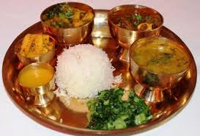


त्रय उपस्तम्भ- ( जीवनका तीन खम्बा)
निद्रा
ब्रह्मचर्य
आहार

Slide 14
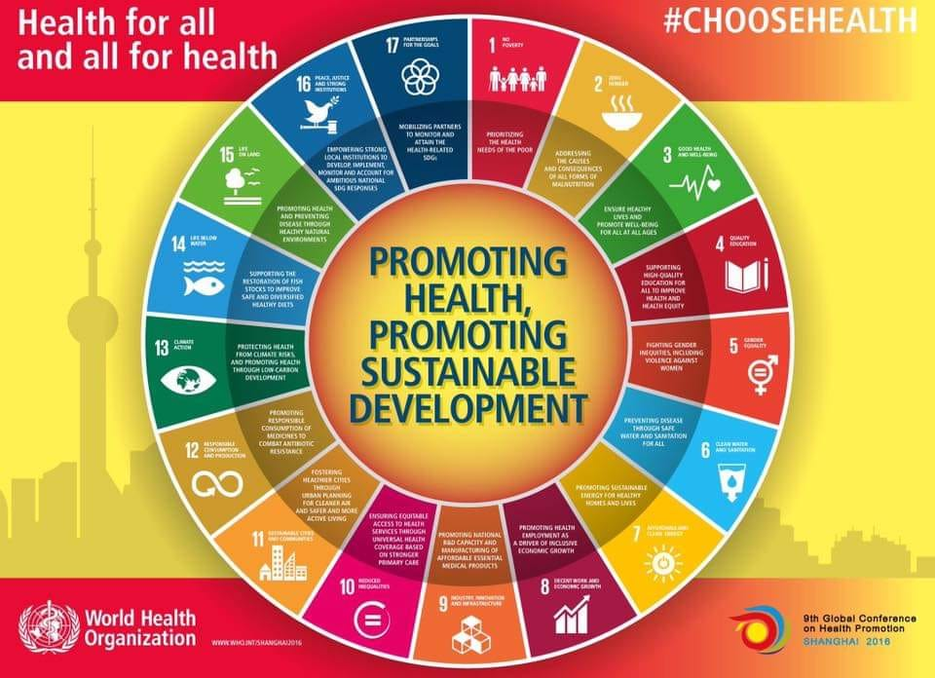
स्वास्थ्य प्रवर्द्बन नै दिगो विकास लक्ष्य प्राप्ती

Slide 15
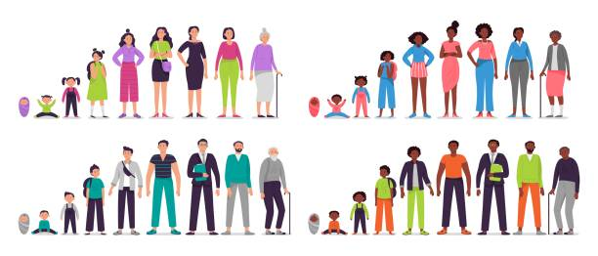
जीवन चक्र
बाल्यं वृद्बि छवि मेधा त्वक् दृष्टि शुक्र विक्रमौ
बुद्धि कर्मेन्द्रिय चेतो क्रमशोः दशतो ह्रसेत्।

Slide 16
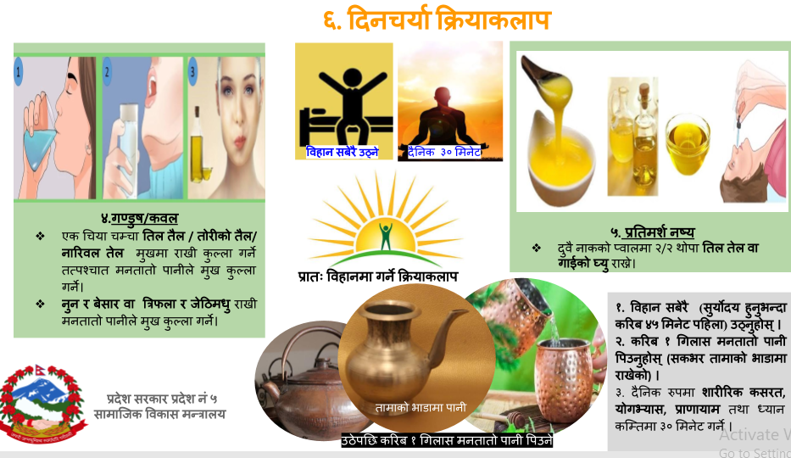

Slide 17
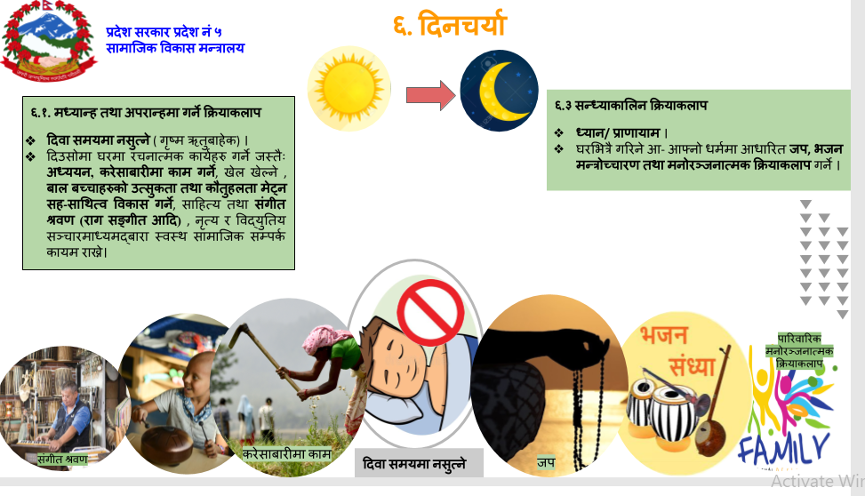

Slide 18
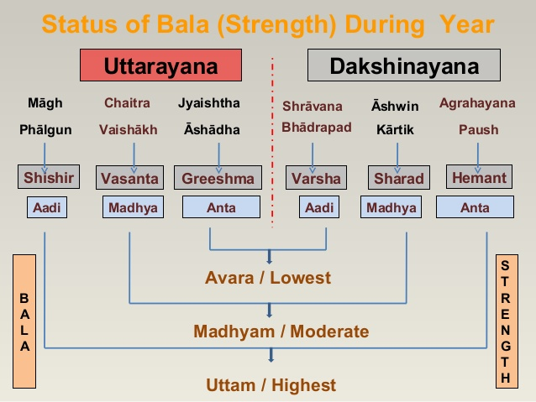
ऋतु परिवर्तन र स्वास्थ्य

Slide 19
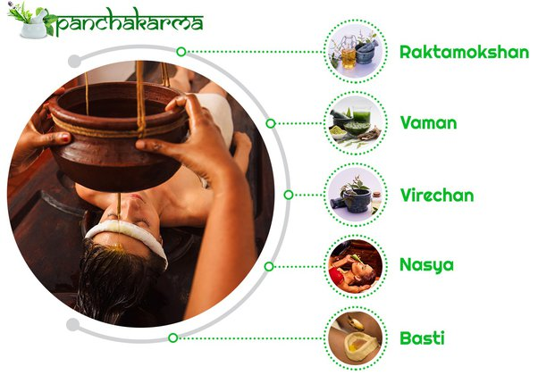

शरीरको आवधिक संशोधन Seasonal Campaigning of Body Purification

Slide 20
तथ्याङ्कीय विश्लेषण

Slide 21
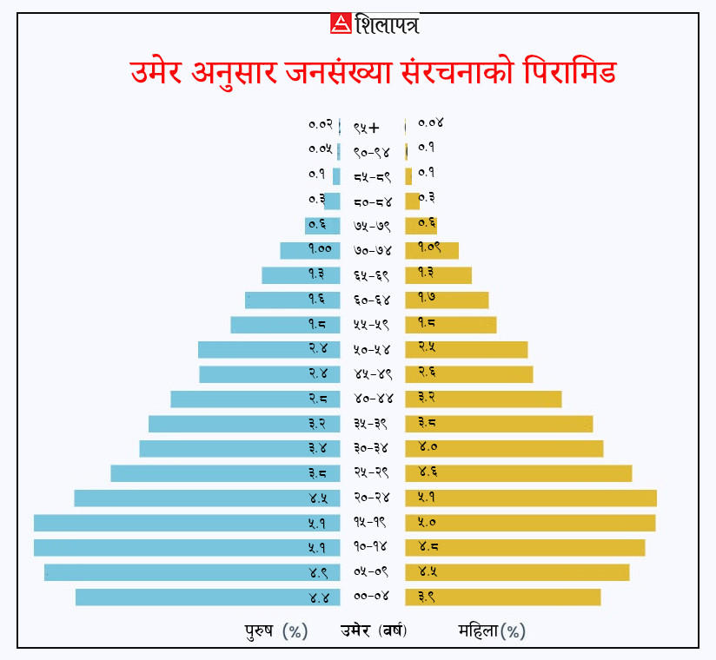
जानसांख्यकि बनोट- जनसंख्या प्रतिवेदन २०७८

Slide 22
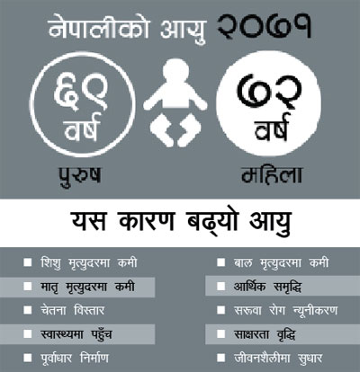
नेपालीको औषत आयु

Slide 23
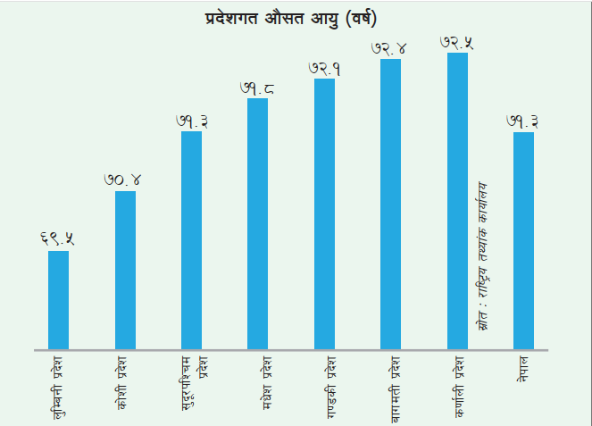
प्रदेशत औषत आयु

Slide 24
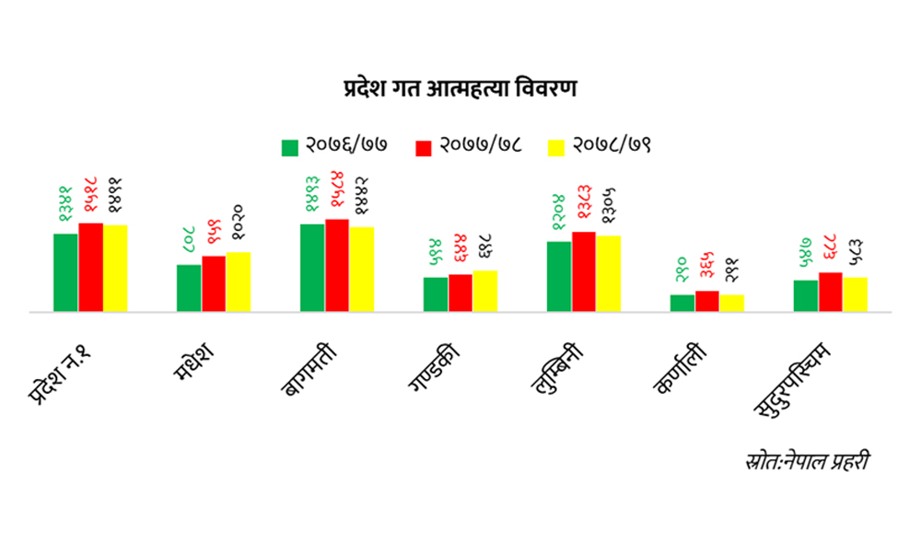
आत्महत्याको अवस्था

Slide 25
Trends in Anemia among Children and Women
Percent of children aged 6-59 months and women aged 15-49 with any anemia
Children
Women
N.A.
N.A.
Notes:
The prevalence of anemia among children age 6–59 months has fluctuated over the past 16 years, declining from 48% in 2006 to 46% in 2011, increasing to 53% in 2016, and then falling to 43% in 2022. The prevalence of anemia among women age 15–49 has fluctuated since 2006. The prevalence decreased slightly from 36% in 2006 to 35% in 2011, increased to 41% in 2016, and subsequently declined to 34% in 2022.

Slide 26
Nutritional Status of Women
Nutritional Status of Men
Percent of men aged 15-19 by body mass index (BMI) for age and women aged 20-49 by BMI
Percent of women aged 15-19 by body mass index (BMI) for age and women aged 20-49 by BMI
Figures > 100% due to rounding.
Figures > 100% due to rounding.
Notes:
Among women age 20–49, data on height and weight were used to calculate two measures of nutritional status: height and BMI. Overall, 10% of women are shorter than 145 cm. One in every 10 women (10%) are thin, while 26% are overweight and 8% are obese. Overall, 27% of young women are of short stature. Twenty-six percent of young women are thin, 5% are overweight, and less than 1% are obese.
Notes: The Body Mass Index (BMI) is expressed as the ratio of weight in kilograms to the square of height in meters. BMI-for-age is expressed in standard deviation units from the median of the WHO Growth Reference for adolescent women age 15-19.
BMI and BMI for age exclude pregnant women and women with a birth in the preceding 2 months.
Overall, 7% of men are thin, while 26% are overweight and 6% are obese. Forty-one percent of young men (age 15-19) are thin, 4% are overweight, and 3% are obese
Notes: The Body Mass Index (BMI) is expressed as the ratio of weight in kilograms to the square of height in meters. BMI-for-age is expressed in standard deviation units from the median of the WHO Growth Reference for adolescent women age 15-19.
BMI and BMI for age exclude pregnant women and women with a birth in the preceding 2 months.

Slide 27

Recent Violence by Husband/ Intimate Partner
Indicator 5.2.2
Recent Violence by Husband/ Intimate Partner by Province
Indicator 5.2.2
Percent of women age 15-49 who have ever had a husband or intimate partner who have experienced violence by any husband/intimate partner in the last 12 months
Percent of women age 15-49 who have ever had a husband or intimate partner who have experienced physical or sexual or emotional violence by any husband/intimate partner in the last 12 months
Notes:
Seventeen percent of women who have ever had one or more husbands/intimate partners experienced physical, sexual, or emotional violence by a husband/intimate partner in the last 12 months; 10% experienced emotional violence, 12% experienced physical violence, and 4% experienced sexual violence.
Women in Madhesh Province are more likely to have experienced physical, sexual, or emotional intimate partner violence by any husband/partner in the last 12 months (32%) than women in the other provinces, the lowest being Bagmati Province (10%),

Slide 28
Trends in the prevalence
Hypertension
Awareness and treatment
Percent of women and men age 15 and older with hypertension:
Percent women and men age 15 and older with raised blood pressure or hypertension
Note: Hypertension = SBP >140 mmHg or DBP >90 mmHg or taking antihypertensive medication.
Notes:
The proportion of respondents age 15 and older with hypertension remained stable between 2016 and 2022. The proportion among women was 17% in 2016 and 18% in 2022, while the proportion among men was 23% in both years.
The results show that 48% of women with raised blood pressure or hypertension are not aware that they have raised blood pressure. Nineteen percent of women with raised blood pressure or hypertension are aware about their condition, report taking medicine, and have their blood pressure controlled within the normal range. Another 16% of women are aware of their condition and taking medication but do not have their blood pressure controlled. Seventeen percent of women are aware about their condition but have not been treated.

Slide 29


Prevalence of anxiety
Percent of women and men aged 15-49 who experienced symptoms of anxiety two weeks prior to the survey
11%
22%
Note: Respondents with a GAD-7 score of 6 or higher.
Notes:
A GAD-7 score of 0–5 is considered mild, while a score of 6–14 is considered moderate and 15–21 is considered severe (Spitzer et al. 2006b). For the purpose of international comparison, in this report respondents age 15–49 are considered to have symptoms of anxiety if their GAD-7 score is 6 or higher. Overall, 22% of women and 11% of men reported experiencing symptoms of anxiety in the 2 weeks preceding the survey.

Slide 30
Tobacco Use
Percent of women and men who are currently using any type of tobacco
Indicator 3.a.1
Age (years)
Alcohol Consumption
Percent of women and men age 15-49 who consumed at least one alcoholic drink in the past month
Notes:
A comparatively higher proportion of men than women used the internet in the last 12 months (76% versus 65%). Among internet users, 64% of women and 70% of men use the internet almost every day.
More men than women use tobacco. Twenty-eight percent of men smoke tobacco, as compared with 5% of women. Among both women and men who smoke tobacco, cigarettes are most common (4% and 28%, respectively).
Includes daily and occasional (less than daily) use.

Slide 31
Number of deaths
Road traffic accidents or crashes
Number of nonfatal injuries
Number of deaths and injuries
Household population in the 12 months preceding the survey
Household population in the 12 months preceding the survey
Household population in the 12 months preceding the survey
Notes:
Nationally, the number of deaths due to road traffic injuries is 14 deaths per 100,000 population. More males (11 deaths per 100,000) than females (3 deaths per 100,000) die due to road traffic injuries in Nepal.
A large proportion of household members are involved in road traffic accidents and have nonfatal injuries. Overall, 1,088 individuals per 100,000 population (301 per 100,000 females and 787 per 100,000 males) sustain nonfatal injuries due to road traffic accidents or crashes.
There were 1,102 deaths and injuries for every 100,000 people due to road traffic accidents and injuries in the 12 months preceding the survey. Deaths and injuries due to road traffic accidents are higher in urban areas (1,236 per 100,000 population) than in rural areas (833 per 100,000 population).

Slide 32
Minimum Acceptable Diet
Unhealthy Feeding Practices
Percent of youngest children aged 6-23 months who received minimum dietary diversity, minimum meal frequency, and minimum milk feeding frequency
Percent of youngest children 6-23 months living with their mother who consumed:
Notes:
Overall, 43% of children were fed a minimum acceptable diet, with children in urban areas receiving a higher minimum acceptable diet (45%) than in rural areas (39%).
Minimum dietary diversity: receiving foods from 5+ of these 8 food groups: breast milk; grains, white/pale starchy roots, tubers, and plantains; beans, peas, lentils, nuts and seeds; dairy products (tinned, powdered, or fresh animal milk, infant formula, yogurt, cheese); flesh foods (meat, fish, poultry, organ meats); eggs; vitamin A-rich fruits and vegetables; other fruits and vegetables.
Minimum meal frequency: for breastfed children, minimum meal frequency is receiving solid, semi-solid, or soft food at least twice a day for infants 6-8 months and at least 3 times a day for children 9-23 months. For non-breastfed children, minimum acceptable diet is receiving solid, semi-solid food or soft food or milk feeds at least 4 times a day. At least 1 of the feeds must be a solid, semi-solid, or soft feed.
Minimum milk feeding frequency: for non-breastfed children, minimum milk feeding frequency is 2 or more feedings of infant formula, tinned, powdered, or fresh animal milk, and yogurt drink or solid.
Overall, 69% of children age 6–23 months consumed unhealthy foods during the previous day, while 43% consumed a sweet beverage. Around one-third (33%) of children were not given any vegetables or fruits.
Sweet beverages include sweet/flavored milk and yogurt drinks, sweet/flavored soy milks or nut milks, fruit juice and fruit-flavored drinks, chocolate flavored drinks, sodas, malt drinks, sports drinks, and energy drinks, sweetened tea, coffee, herbal drinks, and other sweetened liquids.
Unhealthy foods are a group of sentinel food types which include sweet foods such as cake, dessert soup, cookies, sweet popcorn, candy (skar krop), chocolate, or ice cream; and fried and salty foods such as chips, French fries, dried noodle such as Mama.
Vegetables or fruits include dark green, leafy vegetables, such as ivy gourd leaves (slek bas), moringa leaves (slek m’rom), green amaranth (slek pty), morning glory, bok choy (speytteu), mustard greens, pumpkin leaves or sweet leaf bush (slek ngob), cassava leaves, spinach, tree spinach (chaya), kale, wild greens (slek prech), pumpkin, carrots, squash, or sweet potatoes that are yellow or orange inside, ripe mangoes, ripe papayas, passion fruits, and other fruits and vegetables including banana, orange, watermelon, rambutan, durian, or other fruit, tomato, eggplant, cauliflower (pakakhatna), winter melon (tra lach), long bean, mushroom, or other vegetable.

Slide 33



Introduction of Complementary Foods
Breastfeeding
Percent of children under 2 who were
85% of children 6-8 months were fed solid, semi-solid, or soft foods the previous day.
Notes:
Almost all children under age 2 (99%) have been breastfed at some point. Over half (55%) of children are put to the breast within 1 hour of birth, and 59% are exclusively breastfed for the first 2 days after birth.
Note: exclusively breastfed for the first 2 days after birth means that the child was given nothing other than breast milk to eat or drink during the first 2 days after delivery.
Overall, 85% of children were introduced to solid, semisolid, or soft foods at age 6–8 months. Sixty-seven percent of these breastfeeding children received food made from grains; 66% received beans, peas, lentils, nuts, and seeds; 26% received white/pale starchy roots, tubers, and plantains; 18% received vitamin A-rich fruits and vegetables; 11% received eggs; 5% received meat, fish, poultry, or organ meats; and 30% received other fruits and vegetables

Slide 34
Trends in Child Growth Measures
Indicator 2.2.1
Indicator 2.2.2
Stunting by Province
Percent of children under 5 who are malnourished
Percent of children under 5 who are stunted
Stunted
Underweight
Wasted
Overweight
Notes:
The prevalence of stunting and underweight among children under age 5 decreased markedly between 1996 and 2022, from 57% to 25% and from 42% to 19%, respectively. At the same time, wasting declined from 15% in 1996 to 8% in 2022. The proportion of children who are overweight has remained steady at 1% since 1996.
The proportion of children who are stunted is highest in Karnali Province (36%) and Madhesh Province (29%) and lowest in Bagmati Province (18%).

Slide 35
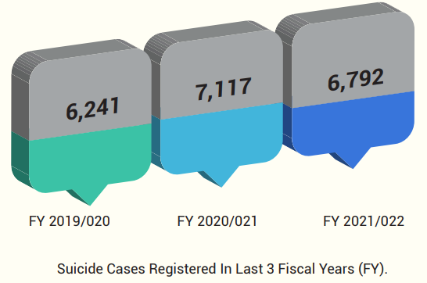
Suicide Mortality Rate
SDG Targets (per 100,000 population)
2019 | 14.5
2022 | 9.7
2025 | 7.8
2030 | 4.7
Source: Nepal Police Mirror, 2022

Slide 36
Life Lost due to Road Traffic Accidents (RTA)
SDG Targets (per 100,000 pop)
2019 | 9.93
2022 | 8.94
2025 | 7.45
2030 | 4.96
Source: Police Mirrors

Slide 37
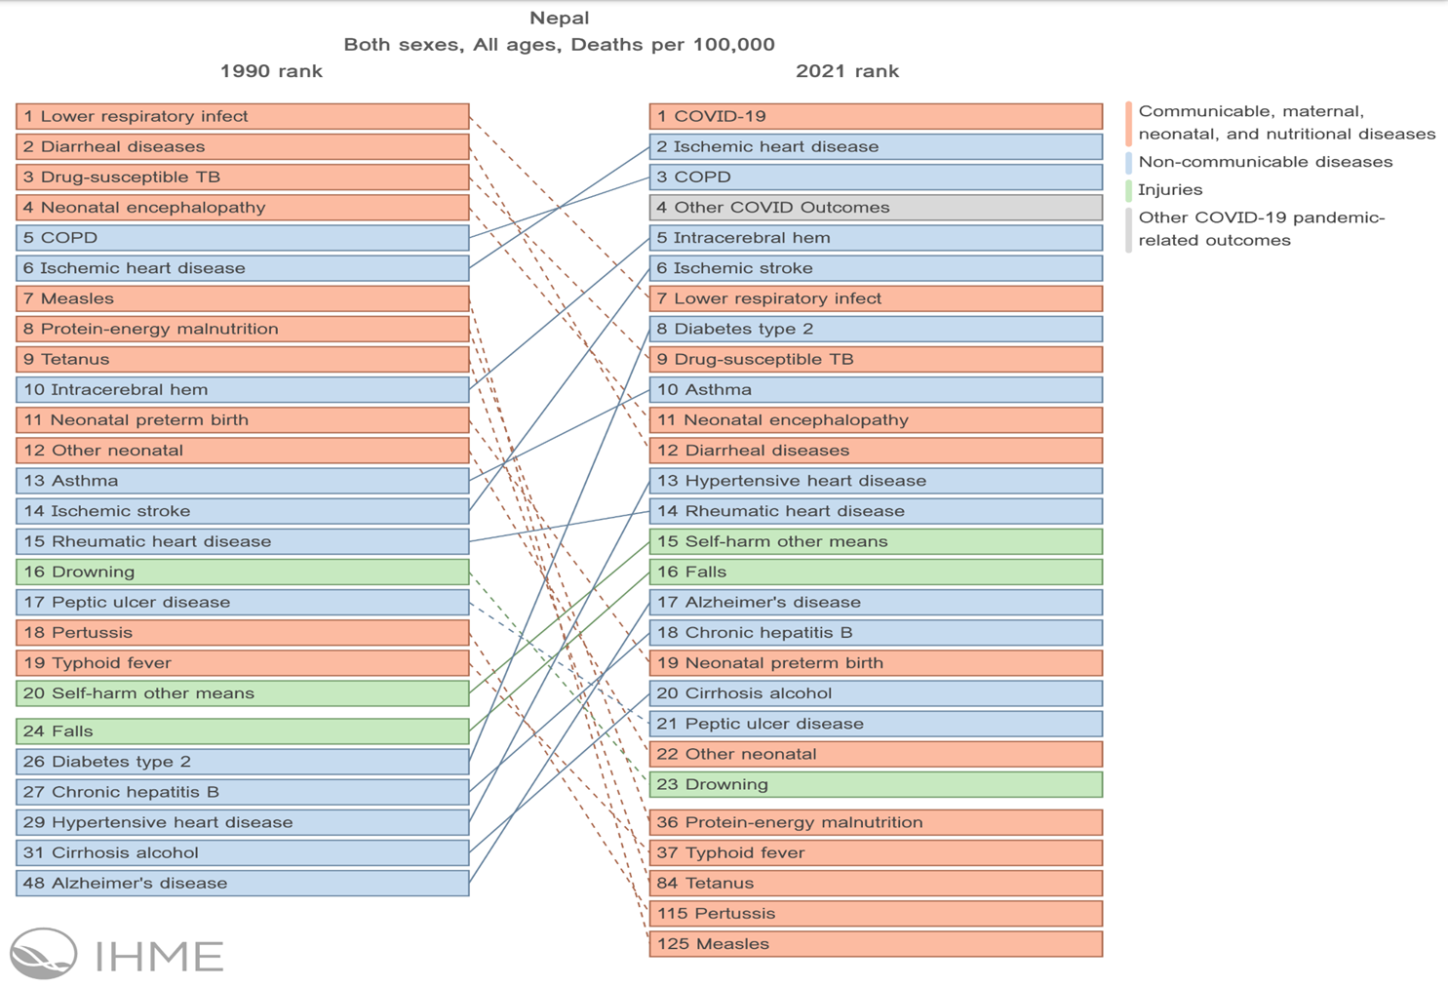
Burden of Disease: Death in 1990 and 2021 रोगको भार परिवर्तन

Slide 38
विश्वव्यापी अभ्यास

Slide 39
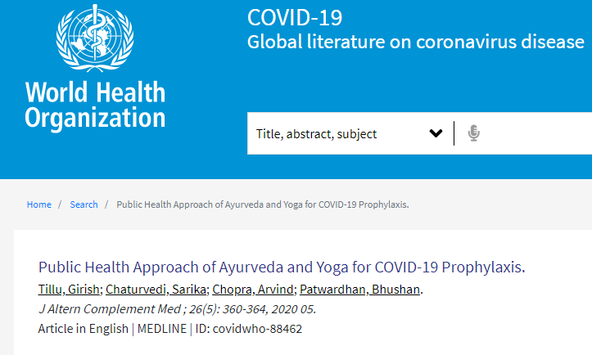
कोभिड १९ मा आयुर्वेद

Slide 40
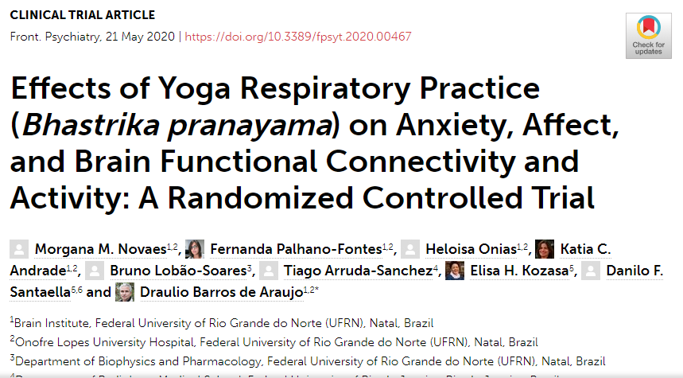
योगद्बारा मानसिक स्वास्थ्य

Slide 41
नागरिक आरोग्य सेवा कार्यक्रमका
सामाजिक असल अभ्यास (कुलत तथा दुर्व्यसनी त्याग, मदिरा तथा सूर्तिजन्य पदार्थ, सहिष्णुता,
जीवनपथमा आधारित स्वास्थ्य
स्वास्थ्य अभियान
पोषण तथा सरसफाई
स्थानीय जडिबुटीद्बारा प्राथमिक स्वास्थ्य रक्षा

Slide 42
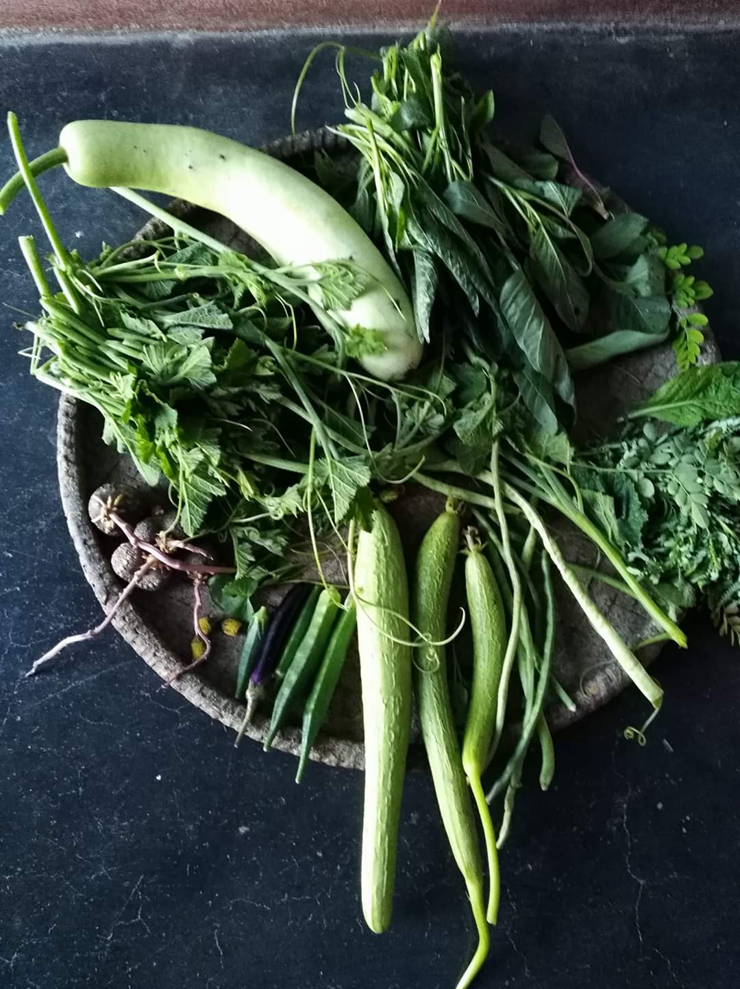

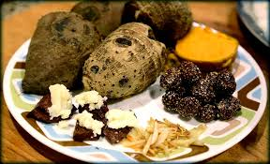
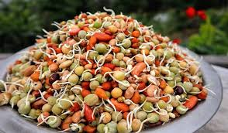
के तपाँईलाई थाहा छ ? यो कुन पर्वसँग सम्बन्धित छ ?

Slide 43
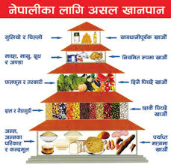
खाद्य पिरामिड
सर्व रसभ्यासं बलकराणां श्रेष्ठं।।
खाद्य विविधता ( Food diversity)

Slide 44
सार संक्षेप सन्देश- स्वस्थ नेपाल, सुखी नेपाली
त्रय उपस्तम्भ – जीवनका तीन खम्बा (आहार निद्रा र ब्रह्मचर्य)
काल भोजनं र व्यायाम स्थैर्यकराणां श्रेष्ठं ( समय बेलामा खाना खाने र दिनहुँ शारीरिक व्यायाम गर्ने
दिनचर्या ( जैविक घडी अनुसार दिनमा गरिने आहार विहार सम्बन्धी कार्यहरु)
ऋतुचर्या (ऋतुकाल अनुसार गरिने आहार विहारहरु)
आवधिक शरीर संशोधन ( शरीरलाई समय समयमा हेरचाह र संभार)

Slide 45
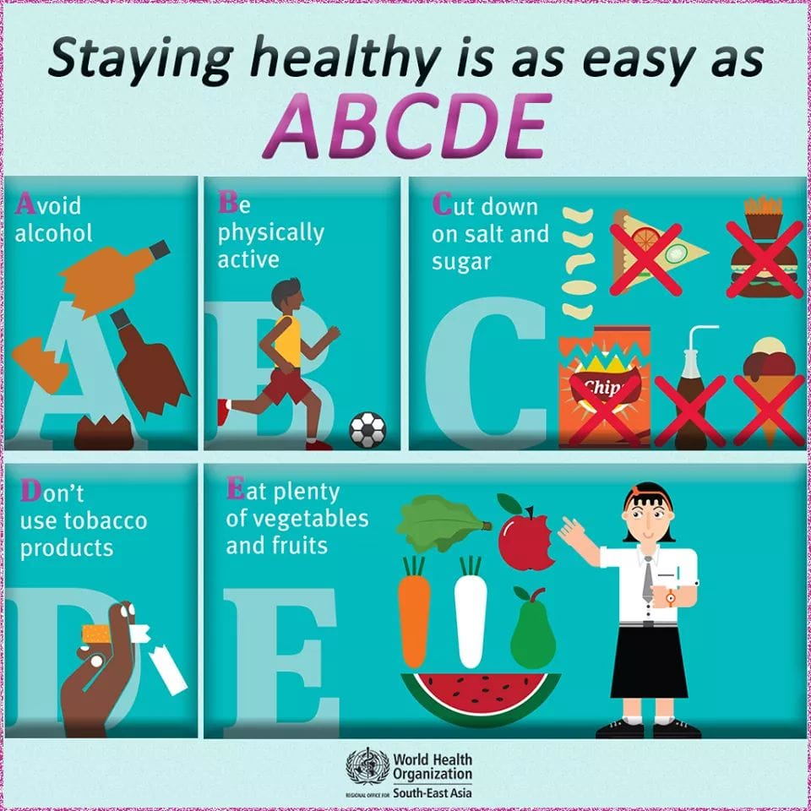
गुरु मन्त्र

Slide 46
